Slide 1
SPRINT 2 REVIEW
AcadMate
Sprint 2 Review
Student progress and advisor approvals
November 7, 2026
01
Notes:
Slide 1: AcadMate
Suggested time: 20 seconds
ENGLISH SCRIPT
Hello, we are Team 3. AcadMate supports academic advising through student progress and advisor workflows. This review presents the local results verified on November 6 and 7, 2026. We will demonstrate the working core and explain the remaining model blocker.
中文操作提示
封面停留约20秒。日期为材料核验日期，不冒充正式 Sprint 2 截止日。
SOURCES (local workspace D:/Repositorys/250)
CS 691 Checklist - new.xlsx / SpringFall - Presentation Slide, rows 60–100 and Wiki requirements
outputs/F2026-Team3-Sprint2-validation-20261106/Sprint 2 功能验收报告.md and accompanying logs / browser-results.json / approval-roundtrip.json
outputs/F2026-Team3-Sprint2-fixes-20261107/导师搜索修复记录.md and advisor-search-results.json
Evidence cut: 2026-11-07. Local Git snapshots, no assertion of the latest remote state. Official Sprint 2 commitment remains unconfirmed.

Slide 2
AGENDA
Today’s review
01
Project and team
People, MVP and design
02
Scope and working software
Backlog, screenshots and test results
03
Metrics and next work
Task log, retrospective and proposed Sprint 3
04
Live application
Student, advisor search and approval flow
02
Notes:
Slide 2: Today’s review
Suggested time: 25 seconds
ENGLISH SCRIPT
We begin with the project and team, then examine the Sprint 2 backlog and acceptance evidence. We explain the sprint metrics and remaining work before a live demonstration. Detailed backlog and reference diagrams follow in the appendix.
中文操作提示
四个部分对应后续页码。主讲不要逐页念附录。
SOURCES (local workspace D:/Repositorys/250)
CS 691 Checklist - new.xlsx / SpringFall - Presentation Slide, rows 60–100 and Wiki requirements
Evidence cut: 2026-11-07. Local Git snapshots, no assertion of the latest remote state. Official Sprint 2 commitment remains unconfirmed.

Slide 3
TEAM
Team roles and introductions
Team member | Role in working agreement
Tafadzwa Nhesvure | Product Owner / AI-ML Developer
Pranali Dukhande | Scrum Master / Backend Developer
Datta Vardhan Reddy Kontham | Database Manager / Backend Developer
Pragnan Chintu Gulivindala | Tester
Liangxian Li | Backend Developer
Lyno Chihwehwete | Frontend Developer / LLM Developer
Saisai Hu | Developer
03
Notes:
Slide 3: Team roles and introductions
Suggested time: 55 seconds
ENGLISH SCRIPT
Each member introduces themselves briefly using the roles in our working agreement. Tafadzwa is the Product Owner and AI/ML developer. Pranali is the Scrum Master and backend developer. Datta handles database and backend work. Chintu is the tester. Liangxian is a backend developer. Lyno works on the frontend and LLM features. Saisai is a developer. We will confirm individual Sprint 2 contributions against the team record before recording.
中文操作提示
逐人说“My name is … and my role is …”。此页只列协议角色，不替成员编造本轮完成贡献。建议分工见讲稿。
SOURCES (local workspace D:/Repositorys/250)
F2026-Team3/Doumentation/Team Agremment/Team-Working-Agreement.docx
F2026-Team3/Doumentation/Presentaions/AcadMate_Sprint1_Presentation.pptx
Evidence cut: 2026-11-07. Local Git snapshots, no assertion of the latest remote state. Official Sprint 2 commitment remains unconfirmed.
Additional presenter context
Updated after professor feedback: each member introduces their role.

Slide 4
PROJECT AND PERSONAS
Academic advising for three users
User | Need | Product response
Student | Understand remaining requirements | Degree audit, credits and course plan
Faculty advisor | Review a student’s plan | Advisee records and approval queue
Administrator | Maintain reliable academic data | Accounts, catalog and data management
04
Notes:
Slide 4: Academic advising for three users
Suggested time: 35 seconds
ENGLISH SCRIPT
Students need to understand their degree progress and prepare a feasible plan. Advisors need to inspect records and make decisions on that plan. Administrators maintain the accounts and academic data behind those workflows. Our product backlog also includes academic risk prediction and a document based assistant, whose completion status we discuss separately.
中文操作提示
三类 persona 是项目既有学生、导师、管理员，不添加虚构访谈、满意度数据。
SOURCES (local workspace D:/Repositorys/250)
F2026-Team3/Doumentation/Sprint Planning/Product Backlog.xlsx / Sheet1
F2026-Team3/Doumentation/Presentaions/AcadMate_Sprint1_Presentation.pptx
Evidence cut: 2026-11-07. Local Git snapshots, no assertion of the latest remote state. Official Sprint 2 commitment remains unconfirmed.
Additional presenter context
Product goal: give students and advisors a shared view of academic progress.

Slide 5
MVP AND SPRINT 1 RECAP
The MVP supports a complete advising flow
Sprint 1 documented foundation
Current verified MVP
Authentication and role access
UI wireframes
Academic data preparation
Student degree progress
Advisor search and student records
Approval visible in the student plan
05
Notes:
Slide 5: The MVP supports a complete advising flow
Suggested time: 35 seconds
ENGLISH SCRIPT
The Sprint 1 deck documented authentication, wireframes and academic data foundations. In the current local build, students can inspect requirements and proposed courses, while advisors can find advisees, review records and approve plans. The student sees the approval after refreshing. That makes the demonstrated MVP useful beyond sign in.
中文操作提示
Sprint 1 回顾依据旧PPT，当前能力依据11月6–7日验收。不要声称所有功能均本轮新开发。
SOURCES (local workspace D:/Repositorys/250)
F2026-Team3/Doumentation/Presentaions/AcadMate_Sprint1_Presentation.pptx
outputs/F2026-Team3-Sprint2-validation-20261106/Sprint 2 功能验收报告.md and accompanying logs / browser-results.json / approval-roundtrip.json
outputs/F2026-Team3-Sprint2-fixes-20261107/导师搜索修复记录.md and advisor-search-results.json
Evidence cut: 2026-11-07. Local Git snapshots, no assertion of the latest remote state. Official Sprint 2 commitment remains unconfirmed.
Additional presenter context
Approval round trip: request 1709 approved, verified in the student UI, then reopened.

Slide 6
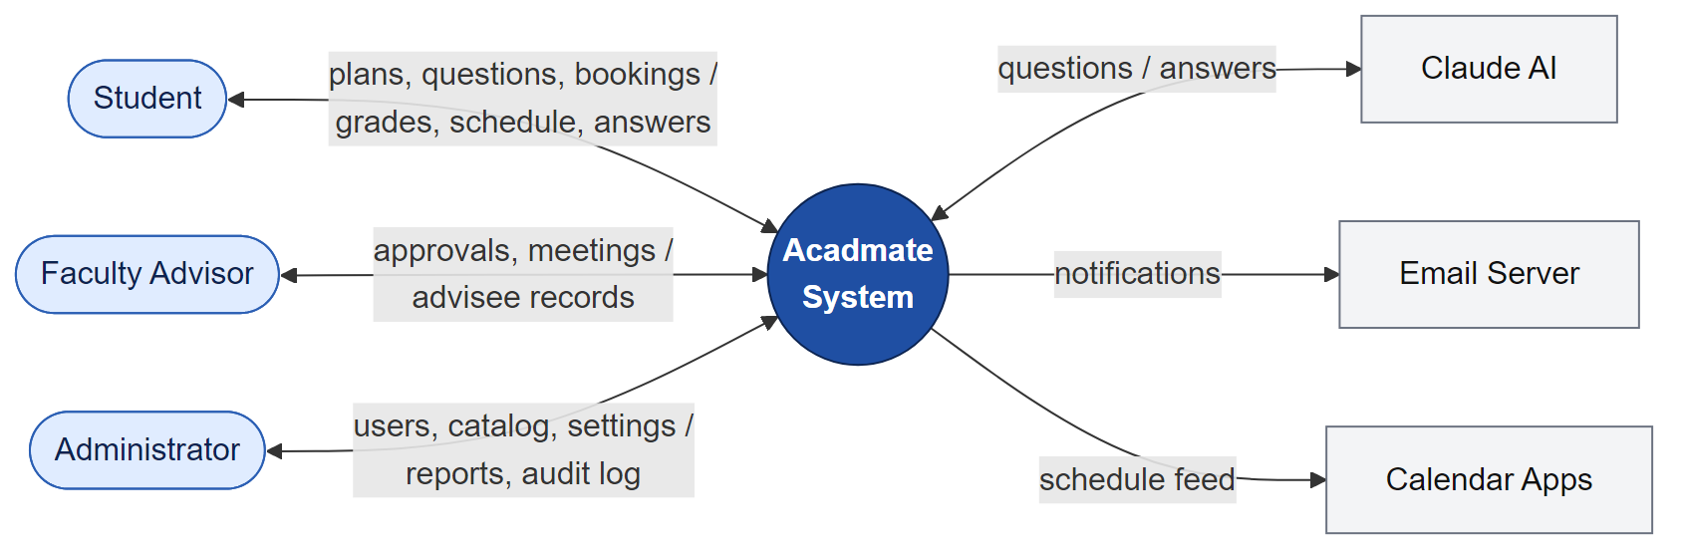
ARCHITECTURE AND TECHNOLOGIES
The local stack separates UI, API and data
React + Vite
FastAPI + SQLAlchemy
PostgreSQL
06
Notes:
Slide 6: The local stack separates UI, API and data
Suggested time: 40 seconds
ENGLISH SCRIPT
The current application uses a React and Vite frontend, a FastAPI backend and PostgreSQL through SQLAlchemy. The repository context diagram shows intended interactions with external services. This diagram is a design reference. The local acceptance run verified the application and isolated database. It did not verify live external AI, mail or calendar providers.
中文操作提示
原仓库图作为设计参考。不要把图上的Claude、邮件和日历连线说成实测通过。当前服务端口见演示讲稿。
SOURCES (local workspace D:/Repositorys/250)
F2026-Team3/Doumentation/Github wiki page/*.png (original repository diagrams)
outputs/F2026-Team3-Sprint2-validation-20261106/Sprint 2 功能验收报告.md and accompanying logs / browser-results.json / approval-roundtrip.json
Evidence cut: 2026-11-07. Local Git snapshots, no assertion of the latest remote state. Official Sprint 2 commitment remains unconfirmed.
Additional presenter context
Repository design reference. External providers require separate acceptance.

Slide 7
ALGORITHMS
Degree audit works, model inference is blocked
Main application
Risk research branch
Requirement group allocation
Earned and remaining credit totals
Rule based advisor attention flags
Logistic regression, 16 features
Sigmoid calibration pipeline
Inference blocked by two missing files
07
Notes:
Slide 7: Degree audit works, model inference is blocked
Suggested time: 45 seconds
ENGLISH SCRIPT
The main application assigns completed and planned courses to requirement groups and computes earned, in progress and remaining credits. Advisor attention flags use rules. The research branch contains an OULAD based logistic regression pipeline with sixteen features and sigmoid calibration. Its frozen model and calibration files are missing locally. We therefore cannot demonstrate model probabilities, SHAP explanations or an approved outreach threshold.
中文操作提示
main规则标记不能讲成ML概率。16特征基于研究配置，学术快照是描述信息。SHAP尚无实现证据。
SOURCES (local workspace D:/Repositorys/250)
outputs/F2026-Team3-Sprint2-validation-20261106/Sprint 2 功能验收报告.md and accompanying logs / browser-results.json / approval-roundtrip.json
outputs/F2026-Team3-Sprint2-scope-20261106/Sprint 2 范围对账.md and scope_data.json
outputs/F2026-Team3-Sprint2-fixes-20261107/冻结模型交接清单.md and model-status.json
Evidence cut: 2026-11-07. Local Git snapshots, no assertion of the latest remote state. Official Sprint 2 commitment remains unconfirmed.
Additional presenter context
Descriptive grades and activity statistics do not establish SHAP explanations.

Slide 8
SPRINT 2 SCOPE CANDIDATE 1 OF 2
Advisor and degree progress backlog
Item | Acceptance criterion from planning | Current evidence
S2-01 Authentication | Required authentication flow works and is tested | Verified locally
S2-02 Advisor UI | Advisor profile screens are complete and reviewed | Flow verified PO review pending
S2-03 Integrations | Required advisor integrations work end to end | Partial
S2-04 Requirements | Requirement groups show correct completion status | Verified locally
S2-05 Credits | Earned and required credits are calculated correctly | Verified locally
08
Notes:
Slide 8: Advisor and degree progress backlog
Suggested time: 40 seconds
ENGLISH SCRIPT
The detailed Sprint 2 planning sheet contains ten tasks. These first five cover authentication, advisor screens, integration and degree progress. Current evidence supports authentication, advisor workflows and degree calculations. The advisor screen review still needs Product Owner signoff. Integration remains partial. These are candidate planning items because the team has not confirmed the official committed scope.
中文操作提示
保留原计划AC含义。Verified表示本地功能证据，不表示PO完成验收。十项计划未填写故事点，不套用26点。
SOURCES (local workspace D:/Repositorys/250)
F2026-Team3/Doumentation/Sprint Planning/sprint_2_task_planning.xlsx / Task Breakdown
outputs/F2026-Team3-Sprint2-scope-20261106/Sprint 2 范围对账.md and scope_data.json
outputs/F2026-Team3-Sprint2-validation-20261106/Sprint 2 功能验收报告.md and accompanying logs / browser-results.json / approval-roundtrip.json
outputs/F2026-Team3-Sprint2-fixes-20261107/导师搜索修复记录.md and advisor-search-results.json
Evidence cut: 2026-11-07. Local Git snapshots, no assertion of the latest remote state. Official Sprint 2 commitment remains unconfirmed.
Additional presenter context
Official committed scope: unconfirmed. Detailed plan items have no recorded points.

Slide 9
SPRINT 2 SCOPE CANDIDATE 2 OF 2
Risk and AI foundations remain open
Item | Acceptance criterion from planning | Current evidence
S2-06 Training data | Dataset is cleaned, documented and ready for training | Branch code Training not rerun
S2-07 Baseline model | Model trains and produces risk predictions | Blocked Frozen files missing
S2-08 Risk thresholds | Thresholds documented and linked to model outputs | Partial Policy unapproved
S2-09 SHAP | Predictions have interpretable SHAP explanations | No evidence
S2-10 Knowledge | Approved sources are ingested and retrievable | No evidence
09
Notes:
Slide 9: Risk and AI foundations remain open
Suggested time: 40 seconds
ENGLISH SCRIPT
The remaining five items cover data preparation, a baseline model, risk thresholds, SHAP and approved knowledge retrieval. The branch contains pipeline code and a synthetic demo dataset. We did not reproduce training on the original OULAD data. Frozen model inference remains blocked. The documented 0.5 threshold is diagnostic rather than an approved advisor policy. No implementation evidence established SHAP or the approved knowledge ingestion and retrieval acceptance criteria.
中文操作提示
不能把branch已有代码写作已完成验收。未完成项是否结转Sprint3由团队正式决定。
SOURCES (local workspace D:/Repositorys/250)
F2026-Team3/Doumentation/Sprint Planning/sprint_2_task_planning.xlsx / Task Breakdown
outputs/F2026-Team3-Sprint2-scope-20261106/Sprint 2 范围对账.md and scope_data.json
outputs/F2026-Team3-Sprint2-validation-20261106/Sprint 2 功能验收报告.md and accompanying logs / browser-results.json / approval-roundtrip.json
outputs/F2026-Team3-Sprint2-fixes-20261107/冻结模型交接清单.md and model-status.json
Evidence cut: 2026-11-07. Local Git snapshots, no assertion of the latest remote state. Official Sprint 2 commitment remains unconfirmed.
Additional presenter context
These evidence categories are not a completion percentage.

Slide 10
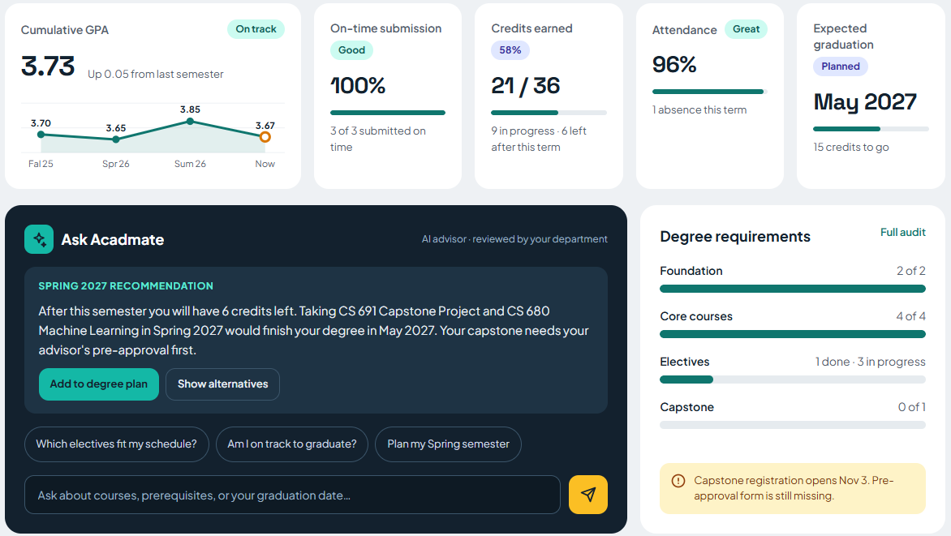
VERIFIED STUDENT WORKFLOW
Students can see remaining degree work
21 / 36
credits earned
9 in progress
6 left after term
10
Notes:
Slide 10: Students can see remaining degree work
Suggested time: 35 seconds
ENGLISH SCRIPT
This screenshot comes from the local student acceptance run. Amara has twenty one of thirty six credits earned, nine in progress and six left after the current term. The requirement groups show foundation and core complete, electives partly complete and capstone remaining. The degree plan exposes the remaining requirements and proposed courses.
中文操作提示
打开学生Dashboard与Degree plan。截图中的 Today 为2026-10-01固定种子日期。AI推荐文案不等于批准知识检索已完成。
SOURCES (local workspace D:/Repositorys/250)
outputs/F2026-Team3-Sprint2-validation-20261106/Sprint 2 功能验收报告.md and accompanying logs / browser-results.json / approval-roundtrip.json
outputs/F2026-Team3-Sprint2-validation-20261106/screenshots/01-student-dashboard.png
outputs/F2026-Team3-Sprint2-validation-20261106/student-audit-plan.json
Evidence cut: 2026-11-07. Local Git snapshots, no assertion of the latest remote state. Official Sprint 2 commitment remains unconfirmed.
Additional presenter context
Real local screenshot with synthetic seed records. Demo clock: October 1, 2026.

Slide 11
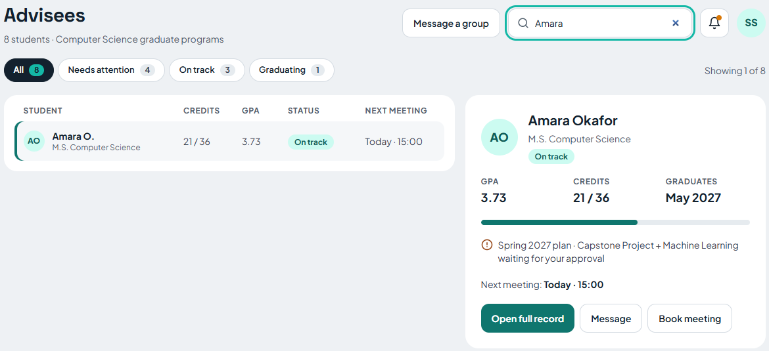
SEARCH FIX VERIFIED NOVEMBER 7
Advisor name search now returns Amara
11
Notes:
Slide 11: Advisor name search now returns Amara
Suggested time: 35 seconds
ENGLISH SCRIPT
The previous browser run found a broken advisor search input. The fix passes the search configuration in the format expected by the shared application header. Searching Amara now returns one student from eight advisees. Seven browser checks passed, including refresh persistence, case insensitive matching, combined filters, empty results and clearing the input.
中文操作提示
先清空筛选，再输入Amara显示1/8。刷新后仍保持。搜索修复在当前工作树，尚未提交。不要把11/6旧套件说成12/12重跑。
SOURCES (local workspace D:/Repositorys/250)
outputs/F2026-Team3-Sprint2-fixes-20261107/导师搜索修复记录.md and advisor-search-results.json
outputs/F2026-Team3-Sprint2-fixes-20261107/screenshots/01-search-amara-fixed.png
Evidence cut: 2026-11-07. Local Git snapshots, no assertion of the latest remote state. Official Sprint 2 commitment remains unconfirmed.
Additional presenter context
7 / 7 fix checks passed. Frontend production build passed. Change remains in the local working tree.

Slide 12
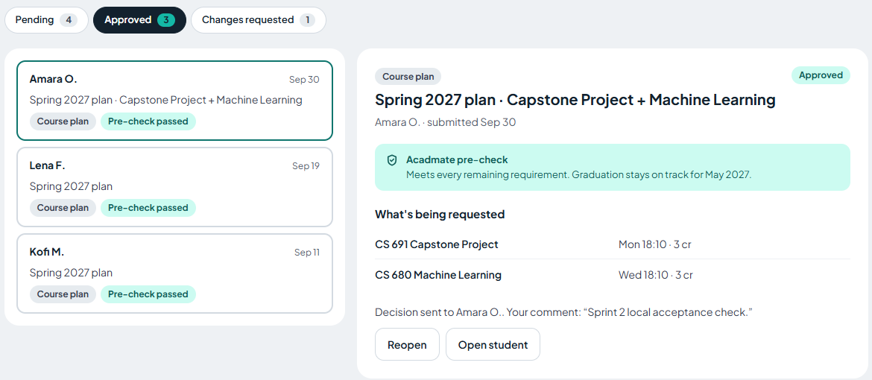
VERIFIED APPROVAL ROUND TRIP
Advisor approval reaches the student plan
Request 1709
CS 691
Capstone Project
CS 680
Machine Learning
12
Notes:
Slide 12: Advisor approval reaches the student plan
Suggested time: 35 seconds
ENGLISH SCRIPT
The advisor opens Amara’s course plan, checks the two proposed courses and approves request 1709. The student then refreshes the degree plan and sees both courses approved. This interaction ran against the local API and database. The acceptance run reopened the request afterward so the workflow can be demonstrated again.
中文操作提示
现场批准只操作隔离演示库。学生刷新确认两门Approved。演示结束导师Reopen恢复Pending。截图是11/6实际执行后的状态。
SOURCES (local workspace D:/Repositorys/250)
outputs/F2026-Team3-Sprint2-validation-20261106/Sprint 2 功能验收报告.md and accompanying logs / browser-results.json / approval-roundtrip.json
outputs/F2026-Team3-Sprint2-validation-20261106/screenshots/11-advisor-plan-approved.png
outputs/F2026-Team3-Sprint2-validation-20261106/screenshots/10-student-plan-approved.png
Evidence cut: 2026-11-07. Local Git snapshots, no assertion of the latest remote state. Official Sprint 2 commitment remains unconfirmed.
Additional presenter context
Student UI verified both courses as Approved. Reopen restored Pending approval.

Slide 13
API AND ACCEPTANCE EVIDENCE
Tests support the demonstrated core
API / test | Role and expected behavior | Evidence
Student degree audit | Student sees earned and required credits | 21 earned / 36 required
Advisor advisee query | Advisor searches Amara | 1 result from 8
Approval request 1709 | Advisor approves, student refreshes | 2 courses Approved
Advisor dashboard access | Student attempts advisor data access | 403 Forbidden
353 backend tests passed
7 / 7 search fix checks passed
13
Notes:
Slide 13: Tests support the demonstrated core
Suggested time: 45 seconds
ENGLISH SCRIPT
The main backend regression run passed 353 tests. The frontend production build also passed. Relevant checks covered degree audit values, advisor search, approval updates and rejection of student access to advisor data. The original browser suite recorded eleven passes and one search failure on November 6. The November 7 fix has seven passing browser checks. These are separate runs, and the backend count covers the wider application.
中文操作提示
353不是Sprint2新增测试数。API实际路由可从OpenAPI查看。旧11/12与新7/7分开报。
SOURCES (local workspace D:/Repositorys/250)
outputs/F2026-Team3-Sprint2-validation-20261106/Sprint 2 功能验收报告.md and accompanying logs / browser-results.json / approval-roundtrip.json
outputs/F2026-Team3-Sprint2-fixes-20261107/导师搜索修复记录.md and advisor-search-results.json
Evidence cut: 2026-11-07. Local Git snapshots, no assertion of the latest remote state. Official Sprint 2 commitment remains unconfirmed.
Additional presenter context
Main frontend build passed with a bundle size warning. Risk inference tests remain blocked.

Slide 14
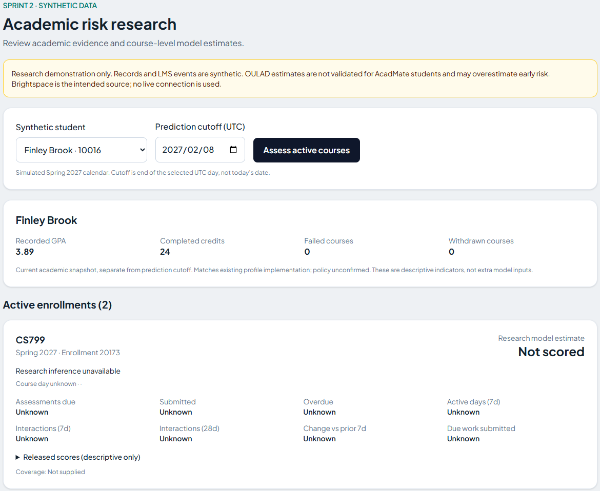
RISK BRANCH DEMONSTRATION LIMIT
The research UI reports “Not scored”
100 students
800 enrollments
Synthetic research data
Two frozen artifacts missing
No model probability available
14
Notes:
Slide 14: The research UI reports “Not scored”
Suggested time: 45 seconds
ENGLISH SCRIPT
The separate research host loaded a synthetic dataset of one hundred students and eight hundred enrollments. It displays academic snapshots and active courses. With the current local files, assessing Finley Brook returns Not scored because the frozen artifacts are missing. The future date February 8, 2027 is a simulated course cutoff. It is not the date of this review. We have no live Brightspace connection or locally reproduced predictive accuracy to claim.
中文操作提示
只演示不可评分处理。学生10016，截点2027-02-08，点击Assess active courses。不要展示伪造概率，也不能把Unknown当零风险。
SOURCES (local workspace D:/Repositorys/250)
outputs/F2026-Team3-Sprint2-validation-20261106/Sprint 2 功能验收报告.md and accompanying logs / browser-results.json / approval-roundtrip.json
outputs/F2026-Team3-Sprint2-fixes-20261107/冻结模型交接清单.md and model-status.json
outputs/F2026-Team3-Sprint2-validation-20261106/screenshots/07-risk-model-unavailable.png
Evidence cut: 2026-11-07. Local Git snapshots, no assertion of the latest remote state. Official Sprint 2 commitment remains unconfirmed.
Additional presenter context
Separate branch host, outside main. Simulated cutoff: February 8, 2027.

Slide 15
PROVISIONAL SPRINT METRICS
The task log records 26 Sprint 2 points
Recorded velocity, points
Recorded completion ratio
Average: 25 points, excluding Sprint 0
24/24 and 26/26, average 100%
15
Notes:
Slide 15: The task log records 26 Sprint 2 points
Suggested time: 50 seconds
ENGLISH SCRIPT
The original task log assigns eight points to backend APIs and nine each to the student and advisor dashboards. All three carry Done status, totaling twenty six points. The same task log gives twenty four for Sprint 1, so the two sprint average is twenty five. These charts describe that task log only. The earlier Sprint 1 deck claimed one hundred ten points, which conflicts with the task log. The team must reconcile the scope before treating these as official velocity or completion metrics.
中文操作提示
用原Tasks行计算24和26，平均25，不把110当作已核准速度。100%仅原日志完成/登记点数，两轮都Done，不代表十项详细计划100%。
SOURCES (local workspace D:/Repositorys/250)
F2026-Team3/Doumentation/Burndown chart/Sprint 1 Burndown.xlsx / Tasks!A1:J9
outputs/F2026-Team3-Sprint2-scope-20261106/Sprint 2 范围对账.md and scope_data.json
F2026-Team3/Doumentation/Presentaions/AcadMate_Sprint1_Presentation.pptx
Evidence cut: 2026-11-07. Local Git snapshots, no assertion of the latest remote state. Official Sprint 2 commitment remains unconfirmed.
Additional presenter context
Provisional log reconstruction. Earlier deck reports 110 for Sprint 1. Official commitment is unresolved.

Slide 16
RECONSTRUCTED CURRENT BURNDOWN
Sprint 2 work closed near the recorded end
16
Notes:
Slide 16: Sprint 2 work closed near the recorded end
Suggested time: 40 seconds
ENGLISH SCRIPT
This reconstruction uses only the three tasks explicitly labeled Sprint 2. The displayed interval runs from the earliest recorded start, September 28, through the last completion, October 9. Remaining work drops from twenty six to eighteen when the backend API task closes on October 5, then to zero when both dashboards close on October 9. The straight ideal line is an illustrative reference, not an original team forecast. The official sprint dates still need confirmation.
中文操作提示
原燃尽图混合Sprint1–3，不能直接改标题。此图只按Sprint2的任务完成日期重建。非正式承诺窗口。
SOURCES (local workspace D:/Repositorys/250)
F2026-Team3/Doumentation/Burndown chart/Sprint 1 Burndown.xlsx / Tasks!A1:J9
outputs/F2026-Team3-Sprint2-scope-20261106/Sprint 2 范围对账.md and scope_data.json
Evidence cut: 2026-11-07. Local Git snapshots, no assertion of the latest remote state. Official Sprint 2 commitment remains unconfirmed.
Additional presenter context
September 28–October 9, 2026. End of day task status. Official dates unconfirmed.

Slide 17
PROPOSED GROUP RETROSPECTIVE
Retrospective actions address observed gaps
Observed issue | Proposed action | Acceptance check
Shared header search broke | Add search behavior to UI review checklist | Match, clear and refresh pass
Model files absent | Owner hands off frozen files and manifest | Both SHA-256 checks match
Scope documents disagree | PO confirms stories, points and dates | One approved Sprint 2 record
17
Notes:
Slide 17: Retrospective actions address observed gaps
Suggested time: 40 seconds
ENGLISH SCRIPT
The local evidence suggests two strengths: repeatable seed data and a successful approval round trip. The search defect and missing model files reveal gaps in shared UI checks and artifact delivery. We propose a short group retrospective that reviews these observations, discusses causes and selects actions with owners. The actions here are proposals for the team to approve. A new meeting and recording have not been evidenced.
中文操作提示
Updated。组会安排：5分钟回顾证据、5分钟每人反馈、5分钟投票选行动和负责人，录制并保存链接。不能将建议说成已举行会议。
SOURCES (local workspace D:/Repositorys/250)
outputs/F2026-Team3-Sprint2-validation-20261106/Sprint 2 功能验收报告.md and accompanying logs / browser-results.json / approval-roundtrip.json
outputs/F2026-Team3-Sprint2-fixes-20261107/导师搜索修复记录.md and advisor-search-results.json
outputs/F2026-Team3-Sprint2-fixes-20261107/冻结模型交接清单.md and model-status.json
F2026-Team3/Doumentation/Presentaions/AcadMate_Sprint1_Presentation.pptx
F2026-Team3/Doumentation/Team Agremment/Team-Working-Agreement.docx
Evidence cut: 2026-11-07. Local Git snapshots, no assertion of the latest remote state. Official Sprint 2 commitment remains unconfirmed.
Additional presenter context
Updated: actionable proposals. Group discussion, assigned owners and recording are pending.

Slide 18
SPRINT 3 PROPOSAL
The next sprint needs a confirmed backlog
Candidate priority | Proposed item | Acceptance before completion
1 | Confirm scope and carryover | PO approves one backlog and estimates
2 | Restore frozen model artifacts | Hashes match and inference cases pass
3 | Approve risk outreach policy | Thresholds map to agreed advisor actions
4 | Complete explainability and retrieval | SHAP evidence and approved-source tests
18
Notes:
Slide 18: The next sprint needs a confirmed backlog
Suggested time: 35 seconds
ENGLISH SCRIPT
We propose first confirming Sprint 2 scope and the carryover decision. For the model work, the team needs the original frozen artifacts, matching hashes and a repeat of the inference acceptance cases. Other candidates are an approved outreach policy, SHAP explanations and approved document retrieval. These items need Product Owner priority, owner assignment and estimates. This is a proposed plan, not a claim of a committed Sprint 3 backlog.
中文操作提示
不擅自移出Sprint2。下表是候选优先顺序，不含虚构承诺点数或实际负责人。与团队确认后再录正式Sprint3承诺。
SOURCES (local workspace D:/Repositorys/250)
outputs/F2026-Team3-Sprint2-scope-20261106/Sprint 2 范围对账.md and scope_data.json
outputs/F2026-Team3-Sprint2-fixes-20261107/冻结模型交接清单.md and model-status.json
F2026-Team3/Doumentation/Sprint Planning/sprint_2_task_planning.xlsx / Task Breakdown
Evidence cut: 2026-11-07. Local Git snapshots, no assertion of the latest remote state. Official Sprint 2 commitment remains unconfirmed.
Additional presenter context
Owners, points and commitment require team agreement.

Slide 19
APPLICATION DEMONSTRATION
The live demo follows the advising workflow
Time | Live action | Expected result
0:00–0:50 | Student dashboard and Degree plan | 21/36 credits and remaining groups
0:50–1:40 | Advisor searches Amara | 1 of 8 advisees, full record opens
1:40–3:10 | Approve request 1709, refresh student | Both planned courses show Approved
3:10–4:00 | Reopen request and optionally show risk | Pending restored, research Not scored
19
Notes:
Slide 19: The live demo follows the advising workflow
Suggested time: 260 seconds
ENGLISH SCRIPT
We will now show the student’s degree progress, search for Amara as an advisor and approve the proposed plan. The student refresh confirms the result. We then reopen the request to restore the demo. If time allows, the separate research host illustrates the current Not scored state. The script provides the exact local addresses, demo accounts and screenshot fallback.
中文操作提示
按讲稿4分钟主流程操作。保留两个浏览器会话。PPT中的真实截图11–13页为备用。风险展示最多30秒。
SOURCES (local workspace D:/Repositorys/250)
outputs/F2026-Team3-Sprint2-validation-20261106/Sprint 2 功能验收报告.md and accompanying logs / browser-results.json / approval-roundtrip.json
outputs/F2026-Team3-Sprint2-fixes-20261107/导师搜索修复记录.md and advisor-search-results.json
outputs/F2026-Team3-Sprint2-fixes-20261107/冻结模型交接清单.md and model-status.json
Evidence cut: 2026-11-07. Local Git snapshots, no assertion of the latest remote state. Official Sprint 2 commitment remains unconfirmed.
Additional presenter context
GitHub: htmw/F2026-Team3. Main snapshot 0eda245. Search fix is local and uncommitted.

Slide 20
APPENDIX A1
Product backlog covers eleven areas
Item | Product backlog area | Recorded scope
PB-01 | Authentication and access | Login, passwords and role permissions
PB-02 | Data import and management | Student/LMS records, validation and error reports
PB-03 | Student dashboard | Academic progress, risk and recommendations
PB-04 | Admin dashboard | Accounts, performance and system settings
PB-05 | Advisor dashboard | Records, progress and pending interventions
PB-06 | Risk prediction and explainability | Model estimates and contributing factors
20 APPENDIX
Notes:
Slide 20: Product backlog covers eleven areas
Suggested time: 0 seconds (appendix, skip in main recording)
ENGLISH SCRIPT
This appendix retains the full set of product backlog areas. All eleven were marked High in the source workbook. Descriptions here summarize scope, not acceptance or completion.
中文操作提示
附录供问答。原Product Backlog没有完整故事AC，不擅自补成已批准标准。Sprint2计划AC见9–10页。
SOURCES (local workspace D:/Repositorys/250)
F2026-Team3/Doumentation/Sprint Planning/Product Backlog.xlsx / Sheet1
Evidence cut: 2026-11-07. Local Git snapshots, no assertion of the latest remote state. Official Sprint 2 commitment remains unconfirmed.
Additional presenter context
All items have High priority in the original workbook. Scope statements do not indicate delivery.

Slide 21
APPENDIX A2
Product backlog continues beyond this sprint
Item | Product backlog area | Recorded scope
PB-07 | Recommendations and interventions | Tutoring, study plans and follow-up tracking
PB-08 | Conversational AI and RAG | Answers grounded in approved university sources
PB-09 | Integration and notifications | SIS/LMS interfaces and academic alerts
PB-10 | Testing, security and performance | Functional, usability, security and load checks
PB-11 | Deployment and feedback | Production configuration, guides and user feedback
21 APPENDIX
Notes:
Slide 21: Product backlog continues beyond this sprint
Suggested time: 0 seconds (appendix, skip in main recording)
ENGLISH SCRIPT
The remaining product areas cover interventions, conversational AI, integrations, quality and deployment. They describe the product roadmap. The current local demo verifies only the flows identified earlier.
中文操作提示
不要将产品路线图条目一律计入Sprint2。
SOURCES (local workspace D:/Repositorys/250)
F2026-Team3/Doumentation/Sprint Planning/Product Backlog.xlsx / Sheet1
Evidence cut: 2026-11-07. Local Git snapshots, no assertion of the latest remote state. Official Sprint 2 commitment remains unconfirmed.
Additional presenter context
All items have High priority. Full descriptions remain in the source workbook.

Slide 22
APPENDIX B
The working agreement defines completion
How the team works
Definition of Done
Zoom discussions, WhatsApp updates
GitHub code and Wiki documentation
Two meetings each week
Acceptance criteria and tests pass
Peer review and integrated UI/API/data
Documentation and PO verification
22 APPENDIX
Notes:
Slide 22: The working agreement defines completion
Suggested time: 0 seconds (appendix, skip in main recording)
ENGLISH SCRIPT
The agreement calls for twice weekly meetings, Jira updates and feature branches with at least one review. Completion includes acceptance criteria, passing checks, integrated changes, documentation and Product Owner verification. The local search fix has runtime evidence but still needs the team review and merge steps.
中文操作提示
协议内容来自原docx。当前搜索修复未提交，所以不标记已满足全部DoD。
SOURCES (local workspace D:/Repositorys/250)
F2026-Team3/Doumentation/Team Agremment/Team-Working-Agreement.docx
outputs/F2026-Team3-Sprint2-fixes-20261107/导师搜索修复记录.md and advisor-search-results.json
Evidence cut: 2026-11-07. Local Git snapshots, no assertion of the latest remote state. Official Sprint 2 commitment remains unconfirmed.
Additional presenter context
Feature branches and at least one reviewer before merge.

Slide 23
APPENDIX C1
Repository architecture documents the layers
Layer | Repository components | Evidence boundary
Browser | React pages, AppShell, API client | Current advisor flow verified
API | FastAPI routers and role checks | Main backend regression passed
Business services | Degree audit, plans and approvals | Approval round trip verified
Storage / providers | SQLAlchemy, PostgreSQL, external adapters | Local DB verified, providers unverified
23 APPENDIX
Notes:
Slide 23: Repository architecture documents the layers
Suggested time: 0 seconds (appendix, skip in main recording)
ENGLISH SCRIPT
This table summarizes the layers documented in the repository architecture diagram. The original diagram still labels advisor pages as placeholders, so it predates the verified advisor workflow. The current acceptance results support the main UI, API and isolated database. External provider connections require separate validation.
中文操作提示
原图历史版本含Advisor placeholders，待维护。为可读性，此页用原生表格概述组件，并区分实测边界，完整原图路径在备注。
SOURCES (local workspace D:/Repositorys/250)
F2026-Team3/Doumentation/Github wiki page/*.png (original repository diagrams)
outputs/F2026-Team3-Sprint2-validation-20261106/Sprint 2 功能验收报告.md and accompanying logs / browser-results.json / approval-roundtrip.json
Evidence cut: 2026-11-07. Local Git snapshots, no assertion of the latest remote state. Official Sprint 2 commitment remains unconfirmed.
Additional presenter context
Architecture summary from the repository diagram. Its advisor placeholder label is outdated.

Slide 24
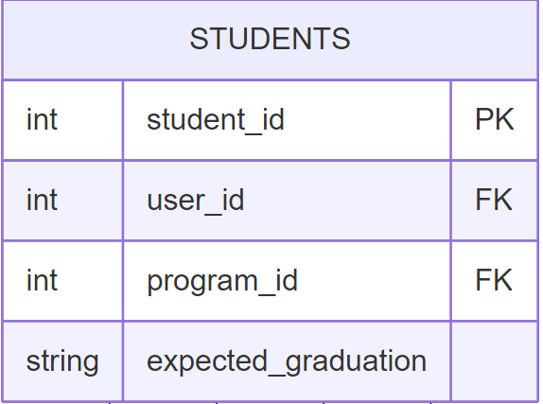
APPENDIX C2
The ER model connects students to accounts
Student entity detail
student_id identifies the student
user_id links the account
program_id links the degree program
24 APPENDIX
Notes:
Slide 24: The ER model connects students to accounts
Suggested time: 0 seconds (appendix, skip in main recording)
ENGLISH SCRIPT
This readable detail comes from the original ER diagram. The student entity includes a primary student identifier and foreign keys for the user and program. The complete diagram also includes enrollment and approval records. This is a design reference rather than a current database schema audit.
中文操作提示
展示原ER图学生实体的局部，不伪称完整ER图。原PNG保留全部关系，可在项目路径打开。
SOURCES (local workspace D:/Repositorys/250)
F2026-Team3/Doumentation/Github wiki page/*.png (original repository diagrams)
outputs/F2026-Team3-Sprint2-validation-20261106/Sprint 2 功能验收报告.md and accompanying logs / browser-results.json / approval-roundtrip.json
Evidence cut: 2026-11-07. Local Git snapshots, no assertion of the latest remote state. Official Sprint 2 commitment remains unconfirmed.
Additional presenter context
Crop from Acadmate_ER_Diagram_Simple.png. Full relationships remain in the original design file.

Slide 25
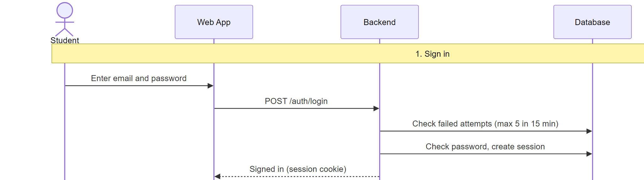
APPENDIX C3
Sign in creates a server session
25 APPENDIX
Notes:
Slide 25: Sign in creates a server session
Suggested time: 0 seconds (appendix, skip in main recording)
ENGLISH SCRIPT
This enlarged sign in detail preserves the original sequence diagram. The web application sends the login request, the backend checks the database and a session cookie returns to the browser. This design reference complements the main authentication tests. Other sections of the original diagram describe intended AI and advising interactions.
中文操作提示
原Sequence图登录部分放大。其他Actor及流程在原PNG中。这里不声称AI外部调用验收通过。
SOURCES (local workspace D:/Repositorys/250)
F2026-Team3/Doumentation/Github wiki page/*.png (original repository diagrams)
outputs/F2026-Team3-Sprint2-validation-20261106/Sprint 2 功能验收报告.md and accompanying logs / browser-results.json / approval-roundtrip.json
Evidence cut: 2026-11-07. Local Git snapshots, no assertion of the latest remote state. Official Sprint 2 commitment remains unconfirmed.
Additional presenter context
Sign-in excerpt from Acadmate_Sequence_Diagram.png. The full source contains additional flows.

Slide 26
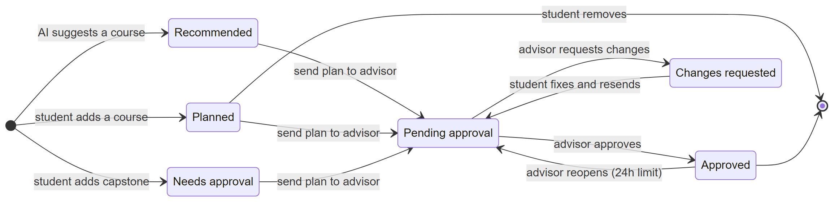
APPENDIX C4
The state model complements runtime checks
26 APPENDIX
Notes:
Slide 26: The state model complements runtime checks
Suggested time: 0 seconds (appendix, skip in main recording)
ENGLISH SCRIPT
This repository state diagram provides another design view. It does not replace functional acceptance. The verified approval case moved from pending to approved and then back to pending when the advisor reopened the request.
中文操作提示
保留原State图。注意原图的具体状态名与审批流程可能不是一一对应，不把设计图当实测轨迹。
SOURCES (local workspace D:/Repositorys/250)
F2026-Team3/Doumentation/Github wiki page/*.png (original repository diagrams)
outputs/F2026-Team3-Sprint2-validation-20261106/Sprint 2 功能验收报告.md and accompanying logs / browser-results.json / approval-roundtrip.json
Evidence cut: 2026-11-07. Local Git snapshots, no assertion of the latest remote state. Official Sprint 2 commitment remains unconfirmed.
Additional presenter context
Runtime evidence remains separate from design documentation.
Original repository state diagram. Acceptance logs document the exercised approval transitions.

Slide 27
APPENDIX D
Model delivery requires the original artifacts
Required artifact | Current state | Acceptance before use
logistic_regression.joblib | Missing | Match frozen SHA-256
calibration_maps.joblib | Missing | Match frozen SHA-256
Supporting frozen source files | 6 verified | Retain matching configuration
Inference acceptance cases | Blocked by missing files | Restore artifacts and rerun
27 APPENDIX
Notes:
Slide 27: Model delivery requires the original artifacts
Suggested time: 0 seconds (appendix, skip in main recording)
ENGLISH SCRIPT
The two required files are logistic_regression.joblib and calibration_maps.joblib. The handoff must include matching SHA-256 values from the frozen configuration. Six small source files passed the existing integrity check, but the two model files remain absent. No replacement model has been trained or substituted. Once the originals arrive, verify both hashes and repeat the currently blocked inference cases.
中文操作提示
用户已明确目前没有两份文件。不要再次追问，也不要以重训替换冻结结果。完整SHA和只读检查脚本见交接清单。
SOURCES (local workspace D:/Repositorys/250)
outputs/F2026-Team3-Sprint2-fixes-20261107/冻结模型交接清单.md and model-status.json
outputs/F2026-Team3-Sprint2-validation-20261106/Sprint 2 功能验收报告.md and accompanying logs / browser-results.json / approval-roundtrip.json
Evidence cut: 2026-11-07. Local Git snapshots, no assertion of the latest remote state. Official Sprint 2 commitment remains unconfirmed.
Additional presenter context
Risk branch PostgreSQL run: 15 passed, 2 failed, 1 error, 1 skipped. No successful model inference claim.

Slide 28
APPENDIX E
Historical burndowns require comparable timing
28 APPENDIX
Notes:
Slide 28: Historical burndowns require comparable timing
Suggested time: 0 seconds (appendix, skip in main recording)
ENGLISH SCRIPT
For historical comparison, this chart normalizes the two reconstructed task windows to percentage of elapsed time. The Sprint 1 total is twenty four points and Sprint 2 is twenty six. The average is the mean of remaining point shares at each normalized interval. This is a reconstructed comparison, not an original team chart. Both recorded completion ratios are one hundred percent, while the official committed denominator remains unresolved.
中文操作提示
按任务登记日期、各自窗口归一化进度，非共同实际日期。平均的是剩余比例不是剩余故事点。主燃尽图仅Sprint2。
SOURCES (local workspace D:/Repositorys/250)
F2026-Team3/Doumentation/Burndown chart/Sprint 1 Burndown.xlsx / Tasks!A1:J9
outputs/F2026-Team3-Sprint2-scope-20261106/Sprint 2 范围对账.md and scope_data.json
F2026-Team3/Doumentation/Presentaions/AcadMate_Sprint1_Presentation.pptx
Evidence cut: 2026-11-07. Local Git snapshots, no assertion of the latest remote state. Official Sprint 2 commitment remains unconfirmed.
Additional presenter context
Task windows reconstructed from September 21–30 and September 28–October 9. Provisional.

